Slide 1
Car Sale Prediction using ANN
Made and presented by Somya Sahana

Slide 2
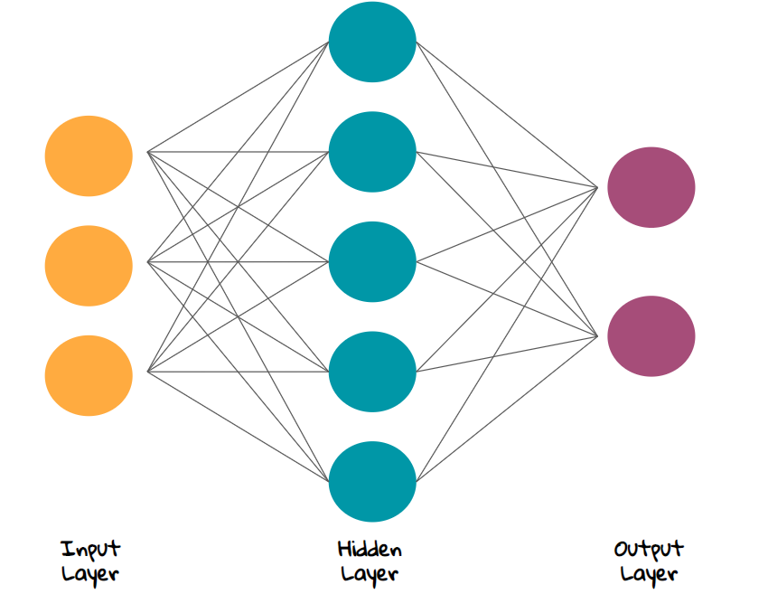
What is Artificial Neural Network?

Slide 3
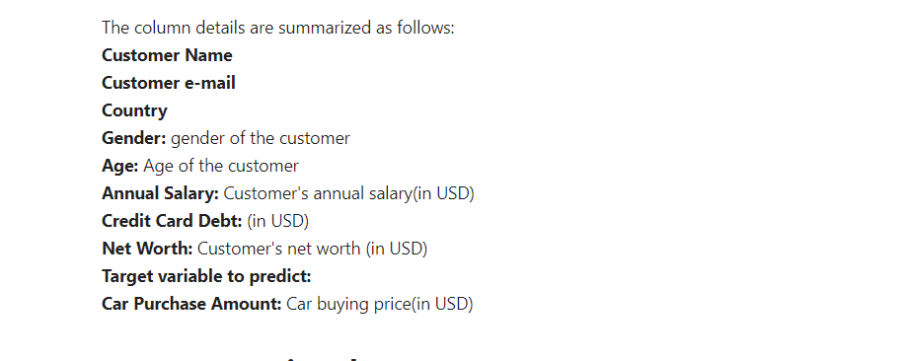
Understanding the Dataset

Slide 4
Division of the Project
Preprocessing
Developing model
Postprocessing

Slide 5
Preprocessing
Remove unnecessary columns.
Check if there is any blank space, INF value, NULL value etc.
Make different graphs and see the relations between different columns.
Check if there is any characteristic data i.e. not numeric data.
If the characteristic data is important, convert them to dummies otherwise remove them.
Find correlation and make heatmap.
Normalize data

Slide 6
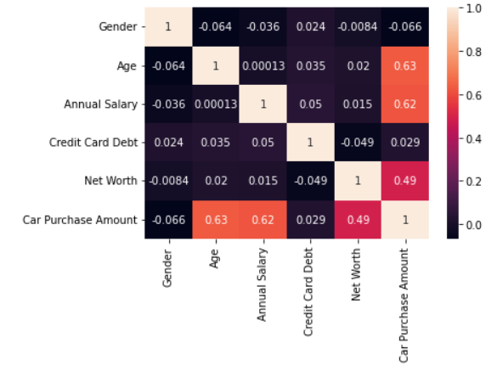
Some Important Preprocessing Steps
1. Heatmap:

Slide 7
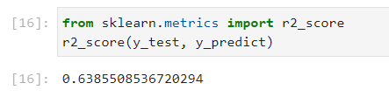

Continued…..
2. Normalizing the data
Model score without normalizing data
Model score with normalizing data

Slide 8
Developing Model
ReLu activation is used for input and hidden layers. Linear activation is used for output layer.
Adam optimizer used
Loss is taken as mean squared error
Total 5 layers are taken
1 input layer
3 hidden layer
1 output layer

Slide 9
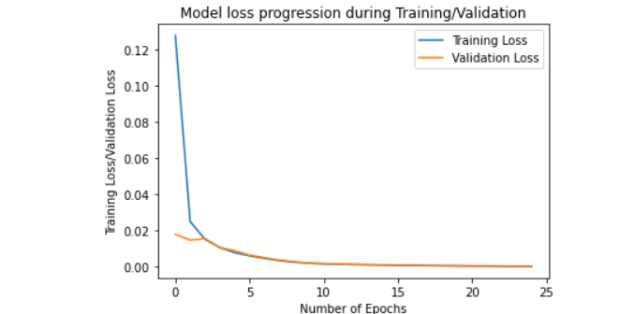
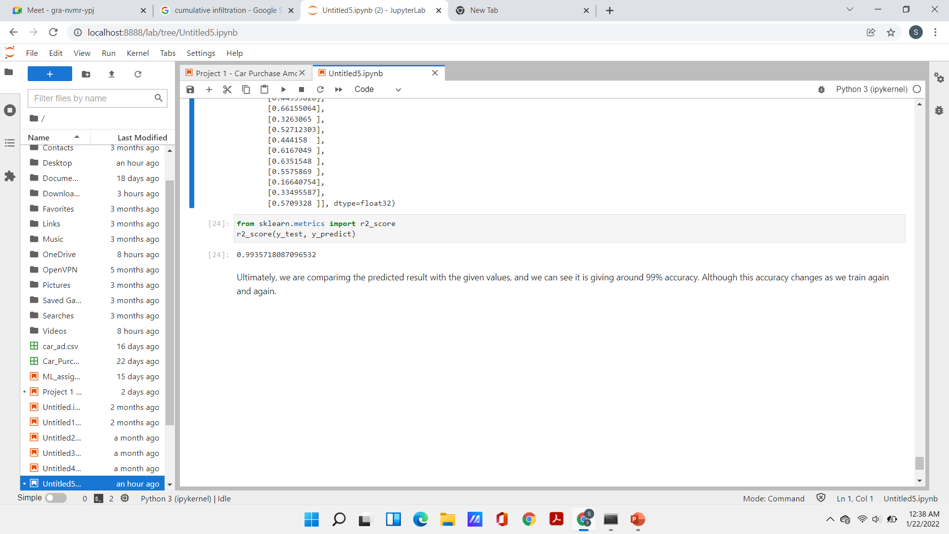
Postprocessing

Slide 10
Conclusion
99% is a pretty good score for a model.
We can change the model by varying the number of layers, activation function, depth of each layers etc., which will vary the model score significantly.
While trying simple machine learning algorithms, like linear regression, random forest regression etc., it was giving a score of around 60-70% which is decent but not good as ANN.

Slide 11
THANK YOU

